Slide 1
WoT Summary and Status
Michael McCool
March 2021

Slide 2




W3C Web of Things (WoT)
W3C Working Group goal: Adapting web technologies to IoT
Already published: Thing Description (TD) metadata format
TD describes the available interactions (network API) of a Thing
New standards work in progress, including Discovery
How does a potential user obtain the TDs for a Thing?
App
App
App
App
App
App
WoT API
WoT API
WoT API
{ properties, actions, events }
MQTT
KNX
TLV
ECHONET
Bearer
EXI
HTTP
OAUTH2
WS
XML
MQTT
KNX
TLV
ECHONET
Bearer
EXI
JSON
Modbus
CBOR
OPC-UA
API Key
HTTP
OAUTH2
CBOR
WS
XML
BACnet
AMQP
JSON
Modbus
BACnet
OPC-UA
API Key
AMQP

Slide 3

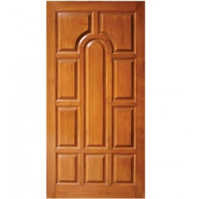

WoT Descriptive Interoperability
WoT Architecture
Constraints
Things must have a TD
Must use hypermedia controls (general WoT)
URIs, standard set of methods, media types
Thing Description Affordances
Describes WHAT the possible choices are
Describes HOW to interact with the Thing
WoT Thing Description (TD)
{
"@context": [
"https://www.w3.org/2019/wot/td/v1",
{ "iot": "http://iotschema.org/" }
],
"id": "urn:dev:org:32473:1234567890",
"title": "MyLEDThing",
"description": "RGB LED torchiere",
"@type": ["Thing", "iot:Light"],
"securityDefinitions": ["default": {
"scheme": "bearer"
}],
"security": ["default"],
"properties": {
"brightness": {
"@type": ["iot:Brightness"],
"type": "integer",
"minimum": 0,
"maximum": 100,
"forms": [ ... ]
}
},
"actions": {
"fadeIn": {
...
Pull
Handle = Affordance
What?
How?
Door = Thing
Open
Turn

Slide 4
Usage Patterns Overview

Slide 5
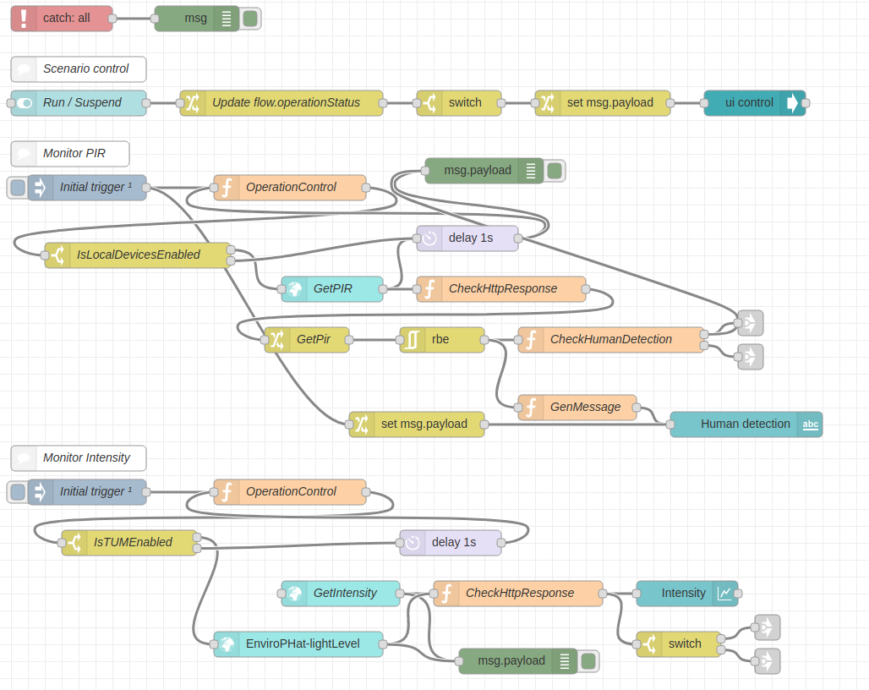

WoT Orchestration
node-wot/Scripting API
Node-RED/node-gen
WoTHelpers.fetch( "coap://localhost:5683/counter" ).then( async (td) => {
// using await for serial execution (note 'async' in then() of fetch())
try {
let thing = await WoT.consume(td);
console.info( "=== TD ===" );
console.info(td);
console.info( "==========" );
// read property #1
let read1 = await thing.readProperty( "count" );
console.info( "count value is" , read1);
// increment property #1 (without step)
await thing.invokeAction( "increment" );
let inc1 = await thing.readProperty( "count" );
console.info( "count value after increment #1 is" , inc1);
// increment property #2 (with step)
await thing.invokeAction( "increment" , {'step' : 3});
let inc2 = await thing.readProperty( "count" );
console.info( "count value after increment #2 (with step 3) is" , inc2);
// decrement property
await thing.invokeAction( "decrement" );
let dec1 = await thing.readProperty( "count" );
console.info( "count value after decrement is" , dec1);
} catch(err) {
console.error( "Script error:" , err);
}
}).catch( (err) => { console.error( "Fetch error:" , err); });

Slide 6
Current WoT WG Charter Work Items
Architectural Requirements, Use Cases, and Vocabulary
Understand and state requirements for new use cases, architectural patterns, and concepts.
Link Relation Types:
Definition of specific link relation types for specific relationships.
Observe Defaults:
For protocols such as HTTP where multiple ways to implement "observe" is possible, define a default.
Implementation View Spec:
More fully define details of implementations.
Interoperability Profiles:
Support plug-and-play interoperabilty via a profile mechanism
Define profiles that allow for finite implementability
Thing Description Templates:
Define how Thing Descriptions can defined in a modular way.
Complex Interactions:
Document how complex interactions can be supported via hypermedia controls.
Discovery:
Define how Things are discovered in both local and global contexts and Thing Descriptions are distributed.
Identifier Management:
Mitigate privacy risks by defining how identifiers are managed and updated.
Security Schemes:
Vocabulary for new security schemes supporting targeted protocols and use cases.
Thing Description Vocabulary:
Extensions to Thing Description vocabulary definitions.
Protocol Vocabulary and Bindings:
Extensions to protocol vocabulary definitions and protocol bindings.

Slide 7
Current Status
New/Updated Normative Documents in Draft Status:
Architecture 1.1: https://github.com/w3c/wot-architecture
Thing Description 1.1: https://github.com/w3c/wot-thing-description
Discovery: https://github.com/w3c/wot-discovery
Profiles: https://github.com/w3c/wot-profile
New/Updated Informative Documents in Draft Status:
Binding Templates: https://github.com/w3c/wot-binding-templates
Scripting API: https://github.com/w3c/wot-scripting-api
Use Cases and Requirements: https://github.com/w3c/wot-usecases
Marketing Improvements:
New Web Site, Animation, Resources: https://www.w3.org/WoT/

Slide 8
Contacts
https://www.w3.org/WoT
Dr. Michael McCool
Principal Engineer
Intel
Technology Pathfinding
michael.mccool@intel.com
Dr. Sebastian Kaebisch
Senior Key Expert
Siemens
Technology
sebastian.kaebisch@siemens.com

